Slide 1
Chapter 3
PROGRAMMING CONCEPTS-II

Slide 2
Approaches to Programming
Understood to a small extent the tools needed for programming
before getting into the actual programming, lets understand various approaches in programming
Programming is a Art or a Skill
Need of a good programmer is by getting a good grasp of the basics and following it up with keen studying and continuous practice

Slide 3
DOS
DOS stands for Disk Operating Systems which could be an acronym for any OS
but it is most often used as a shorthand for MS-DOS (Microsoft Disk Operating Systems)
Originally deployed by Microsoft for IBM
Initial versions of DOS were very simple and resembled another operating system called CP/M (Control Program for Microcomputers)
DOS is still a 16-Bit OS, does not support multiple users or multitasking
DOS in sufficient for graphical operations
All windows have strongly dependency on DOS
Newer version of DOS are inbuilt in all windows OS
DOS is considered to control hardware directly

Slide 4
BIOS and DOS function calls
Till now we were viewing 8086 processor as being connected only to memory i.e physical memory RAM
But in reality Processor is also connected to various input and output devices
As a programmer, we would like to input data into the processor using KB and get the results displaed on the monitor
for we need to access the I/O devices, which contain a lot of extra hardware
Software available to handle these problem, they come in the form of functions written to access input and output devices
BIOS (Basic Input Output Systems) consists of set of functions written for this purpose

Slide 5
There is another set of functions called DOS functions or DOS interrupts
They are part of DOS operating system
there are written for accessing input and output devices
called in the form of software interrupts
one such DOS interrupt that .EXIT statement (shorthand notation) gets translated into:
MOV AH, 4CH
INT 21H
here 4CH is the function number which has to be loaded to the AH register before calling the interrupt with type 21H
This function cause exiting the program & returning to the DOS prompt

Slide 6
Using DOS function calls
Start with 4 important function calls, all of which are of interrupt type 21H
i)Read the keyboard with echo MOV AH ,01 INT 21H
This call exits with the ASCII value of the key pressed being available in AL
Key pressed is also echoed on the screen

Slide 7
ii)Read Keyboard without echo
MOV AH ,08
INT 21H
This call exits with the ASCII value of the key pressed being available in AL
key pressed is not echoed on the screen

Slide 8
DISPLAYING A CHARACTER
iii)Write a character to the standard display unit.
For this ,the ASCII value of the character to be displayed should be in DL
MOV DL , ‘S’
MOV AH ,02
INT 21H
with this the character S is displayed on the screen

Slide 9
STRING DISPLAY
iv) Display a character string on the standard display unit
The logical address DS:DX should point to the beginning of the string .
This is to be followed by the following instructions
MOV AH ,09
INT 21H

Slide 10
The Instruction set of 8086
Instruction set of 8086 is reasonable large
Besides each instructions are used in various addressing modes
Some of the features are:
Most instructions have 2 operands (Destination & Source ). These can be registers or memory operands.
If there are two operands, one of them should be in a register ,or an immediate operand
If only one operand ,it can be a destination or a source
In some cases, the operand is implicit in the usage of these instructions

Slide 11
DATA TRANSFER INSTRUCTIONS
MOV- Move
Usage: MOV destination, source
This instruction is for copying the source content to the destination
data types of source and destination should be match- either bytes or word
MOV AX,CX ; copy CX to AX- word operation
MOV AL,AH ; copy AH to AL- byte operation
MOV AX,[BX] ;copy into AX the data in the address pointed by BX
MOV COST,DX ; copy the word in DX to the location labeled COST

Slide 12
MOV instruction in the register and immediate addressing modes were covered earlier
we will use MOV in other addressing modes
. MODEL SMALL ; select small model
.DATA ; start data segment
COSTP DB 67H ; store cost price
SELLP DB ? ; space for selling price
.CODE ; start code segment
.STARTUP ;start program
PROFIT EQU 25H ;define the profit
MOV AL,COSTP ; move COSTP to AL
ADD AL, PROFIT ; add profit to AL
MOV SELLP, AL ; store sum in SEELP
.EXIT ;exit to DOS
END ; end of program

Slide 13
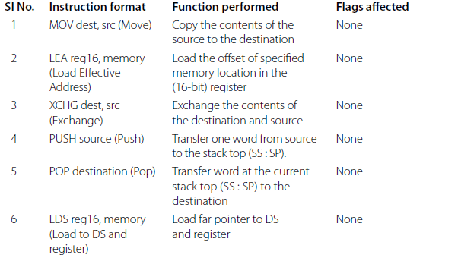
List of 8086 data transfer instructions with format & functions

Slide 14
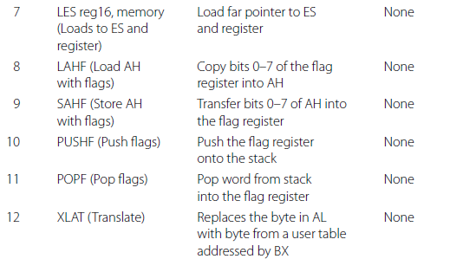

Slide 15
previous eg use mov instruction in the direct mode of addressing
this mode uses a memory location as one operand
here two memory locations labeled COSTP and SELLP have been defined in DS
COSTP has a data byte stored in it
SELLP is only allocated space for later storage
MOV instruction gets the data byte in COSTP into AL
After adding the sum in AL is stored in SELLP
Both MOV use direct addressing
remember the assembler will do the conversion of the labels to memory address

Slide 16
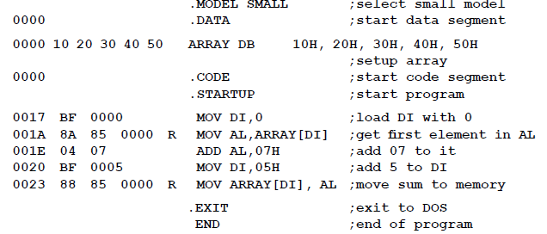
Example 3.2-register relative addressing

Slide 17
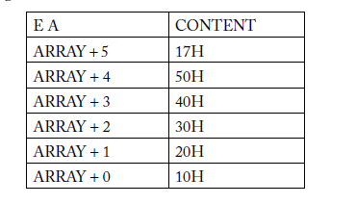
DS is first initialized with 5 bytes
address of the first location is labeled as ARRAY
DI is used to address the element numbers (with DI=0 1st element is accessed, DI=5 last element)
EA will be [Array + DI]
When DI=0, it will be Mov AL, Array[DI]
Add 07, with DI=5 Array[DI] becomes address of the sixth location in memory

Slide 18
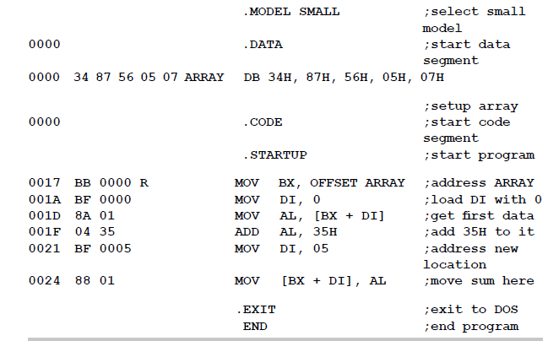

Slide 19
uses base indexed mode of addressing
EA= base reg + index Reg
MOV BX, offset array causes the offset of Array to be loaded into BX
BX is now a pointer to the location labeled Array
to point each element one by one, another register DI is also used
With DI=o, the instruction MOV AL, [BX+DI] causes the data in the first location to be copied to AL
with DI=5, [BX+DI] access the sixth location in the data segment

Slide 20
LEA - Load Effective address
Usage: LEA reg16, memory
this instruction causes the offset of the specified memory location to be loaded in the indicated register:
LEA SI,COSTP ; load the offset of memory location COST in SI
LEA BX, ARRAY ; load the offset of memory location ARRAY in BX
Above is a replacement for the instruction MOV BX, OFFSET ARRAY of previous example
lets see instruction for, display of two character strings on two lines on the monitor
DOS function calls are needed for this

Slide 21
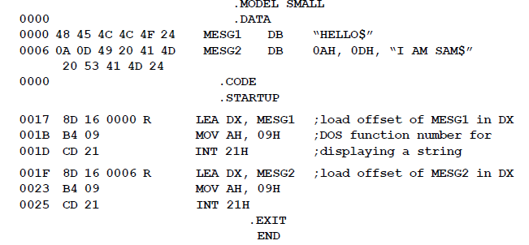

Slide 22
Output
HELLO
I AM SAM
C:\masm6.14\BIN>
Analyze the program
In the data segment, two messages are stored at offsets with labels MESG1 and MESG2
character strings are enclosed in double quotes and terminated by the $ sign
sign is mandatory to end a character string which is to be printed on the display device
Eg shows the corresponding ASCII value for each character of the string
ASCII value for space between each word of the second message i.e I AM SAM
it is 20H, note that 24H is the ASCII value for $

Slide 23
Second line, we also see two characters 0AH and 0DH
ASCII value for line feed and carriage return
to print 1st message, DX points to the offset MESG1
using LEA instruction, which loads the offset of MESG1 in DX
DOS function with number 09H is called
for second message, DX should point to the offset of MESG2
Two messages as they are printed on the command window are seen
.EXIT command causes control to return to DOS prompt

Slide 24
XLAT -Translate a byte in AL
Usage: XLAT
this translates a byte in AL
XLAT is an instruction that can handle look up tables and access data depending on the value of the pointing number
one-to-one relationship between the number and the data in the table
Before using XLAT, look up table must be in a memory and the offset of the table must be in BX
Requirements : load into BX ,the offset of the look up table . Then use XLAT
into AL, load the number which will extract the required data

Slide 25
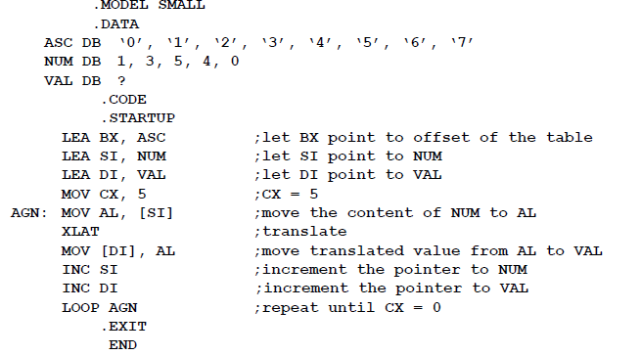
Write a program that gets into the memory location starting from VALUES, the ASCII values of 1, 3, 5, 4, 0 … in that order. The look-up table is stored in the array named ASC

Slide 26
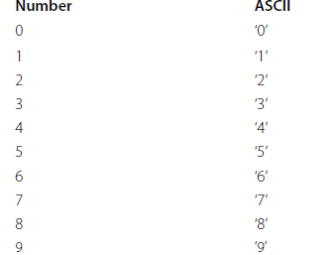
Look-Up Table for Decimal to ASCII Conversion

Slide 27
XLAT is equivalent to the following instructions:
MOV AX, 0
MOV SI, 0
MOV AL, [BX + SI]
SI or DI will be okay for showing the equivalence.

Slide 28
Push & Pop
The 8086 stack
Is a LIFO stack
the lowest address is the base address of the stack segment .
The upper 16 bits of this base address will be in the SS register .
The highest address will be in the SP register
–or rather ,the SP will contain the offset of the highest address with respect to the base address .This is why it is called the TOP of STACK

Slide 29
Stack
If the stack is defined from addresses 20000H to 203E8H , SS=2000H and SP=03E8H,.This stack then has a size of 3E8H bytes.
In the 8086 ,only a word (16 bits ) can be pushed on to stack .
A push thus causes two memory locations to be accessed –
Ex: from the above SP mentioned, lets say PUSH BX instruction is executed
Let BX=CC99H, with SP=03E8H, the operation of pushing is as follows:
SP is first decremented by two
The new data will be put in addresses (offsets) 03E7H (SP-1) & 03E6H (SP-2).
It follows the ‘little endian ‘concept by higher byte of BX will be higher address & lower byte is the lower address

Slide 30
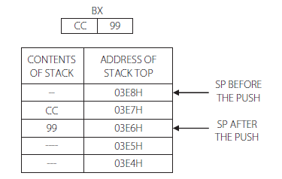
OPERATION OF THE STACK if BX has the content CC 99 and the instruction is PUSH BX-

Slide 31
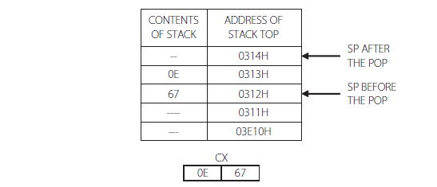
Reverse will be the case for POP operation
Assume POP CX operation at the time when SP is 0312H
the content of the stack will be first loaded to the CX register
With incrementing SP by two

Slide 32
PUSH and POP
Usage : PUSH source
POP destination
PUSH BX ; save the contents of BX to stack
PUSH [BX ] ; save to stack the contents of the word pointed by BX
PUSH DS ; save to stack the contents of the segment register DS
PUSH COSTP ; save to stack the contents of the word location COSTP
POP CX ; load the contents of the stack top to CX
POP [SI] ; load the contents of the stack top to the memory location pointed by SI

Slide 33

Defining a stack
how to use stack in programming?
Is stack is not defined it shows warning ‘ No stack segment’ appear on assembling
This can be ignored
To define

Slide 34
Explain what is done in this program .Assume SP =0310H ,when the stack was initialized
.MODEL SMALL
.STACK 300H
.CODE
.STARTUP
MOV AX,4567H
MOV BX,0ACEH
PUSH AX
PUSH BX
POP AX
POP BX
.EXIT
END

Slide 35
Program defines a stack of 300 bytes by the use of the stack directive
It loads two numbers in AX & BX
Later these numbers are pushed into stack using PUSH operation, followed by POP operations.
Note that POPing occurs in reverse direction
what is pushed in last will be popped out first
the last PUSH was PUSH BX
hence by the POP AX operation, the content of AX is replaced by the content of BX
Similarly the second POP causes the BX to get the content of AX
Thus this program will exchange the contents of these two registers, using the stack as a temporary data storage area
After execution, the contents of the registers are: BX=4567H & AX=0ACEH

Slide 36
Branching Instructions
Branching instructions is very important as they carry the full power of a computer
Branching can be of two types: Conditional & Un-Conditional
Unconditional branching becomes necessary when looping back or forward is done infinitely (Like generating square wave)
Conditional branching is what may be more important
taking decisions based on the result of a computation that gives computers their power & versatality
Most instructions becomes meaningful when only conditional branching is used.

Slide 37
JMP- Jump
Usage: JMP destination
Here destination is a memory location
Jump destination is referred as ‘target’
Jump instructions breaks the normal sequence of program execution and takes control to a different location in code segment
small example
MOV…..
ADD,-----
JMP AGAIN
………..
--------
-
-
------------
AGAIN: ……..

Slide 38
When the ADD instruction is being executed , IP(Instruction Pointer) points to the next instruction which is an unconditional JMP instruction .
On decoding the JMP instruction ,the EU(Execution Unit) realizes that the next instruction should be taken from the location with label AGAIN .
It is obvious then , that the IP content must be changed in such a way that a new sequence is to be followed .

Slide 39
Salient Points Regarding Jump
The label of the destination address should be followed by a colon.
Jumping can be backward or forward in the program sequence
Jumping can be unconditional .Then the format of the jump instruction is
JMP label ,where label is the address of the destination
JMP can be conditional, based on the state of the flags which gets affected by arithmetic or logic instructions

Slide 40
Types of Jump Instructions
an intrasegment (within segment) or near jump-needs a new value for IP
jump location may be in a different code segment –
i.e. inter segment -then it is called a far jump –needs a new value for CS and IP

Slide 41
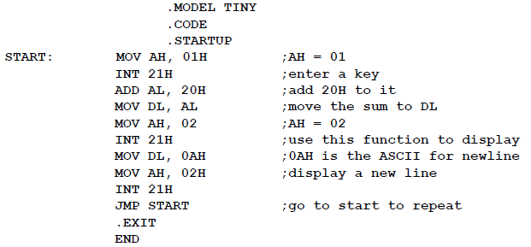
Example

Slide 42
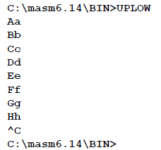

Slide 43
Other Forms of the Unconditional Jump Instruction
i) JMP reg16
This is called an indirect jump
The 16-bit registers contains the destination address (OffSet)
This Jump is not a relative jump
IP gets replaced by the value in the register
examples:
JMP BX ;jump to the destination address in BX. Make IP=BX
JMP SI ; jump to the destination address in SI. Make IP=SI

Slide 44
ii. JMP [reg 16]
The register points to an address which contains the jump location
e.g.JMP [SI] ; jump to the address which is stored in the memory location pointed by SI

Slide 45
CONDITIONAL JUMPS
Conditional jumps are the best part of the idea of control transfer. They change the sequence of
program execution based on the result of a computation which causes flag bits to be set or reset.
However, there is one case ( JCXZ) where the register content is checked.

Slide 46
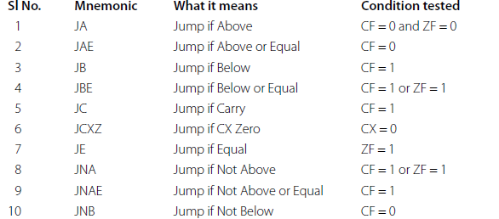
List of Conditional Jump Instructions which Cater to Unsigned Arithmetic and which Directly Address Flags or Registers

Slide 47
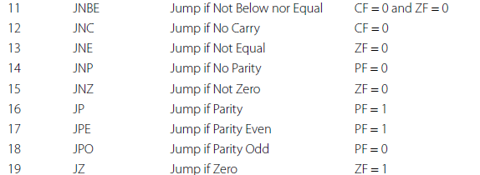

Slide 48
FAR Jump
A far jump is an intersegment jump, which means that the destination address is in a different code segment.
This will be a 5-byte instruction, the first byte being the opcode, the second and third, the new value of IP, and the fourth and fifth, the new values of CS.

Slide 49
The LOOP Instruction
Usage: LOOP label
This combines jump with a counter.
The register CX is assigned to decrement every time LOOP executes. When CX = 0, the looping is exited.

Slide 50
What is to be understood here is that, the sequence of instructions up to the line containing the LOOP instruction, will execute once.
Then, when the LOOP instruction is encountered, CX is decremented and then tested. If CX is found to be equal to zero, looping is exited and the next instruction in the sequence is taken up.
If CX! = 0, control returns to the label MORE.

Slide 51
LOOP can be combined with other conditions, to make it a conditional instruction.
LOOPNE / LOOPNZ and LOOPE / LOOPZ can be used.
These instructions test the zero flag, as well as the value of CX

Slide 52
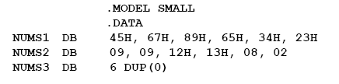

Slide 53
Arithmetic Instructions
Complete list of Arithmetic instructions is shown below
Instruction from 1 to 9 are discussed in detail
For signed number arithmetic is discussed later

Slide 56
Flag Control Instructions
Certain instructions which can be used to set/reset flags
very relevant in case of flags like direction flag, interrupt flag etc..
There is one conditional flag which can be set/reset using instructions, and that is the carry flag.
Relevant instructions to it are:
i) CLC – Clear carry.
ii) STC – Set carry.
iii) CMC – Complement carry
some of the important and commonly used arithmetic instructions with its format & usage are discussed.

Slide 57
Addition Instructions
ADD – Add.
Usage: ADD destination, source.
This instruction adds the destination and source and puts the sum in the destination. All conditional flags get affected.
Examples…
ADD AH, AL ; add AL to AH, sum in AH
ADD AL, COSTP ; add the byte in COSTP to AL, sum in AL
ADD BX, 0987H ; add the number 987H to BX, sum in BX
ADD CX, [BX] ; add the word in the location pointed by BX to CX sum in CX

Slide 58
ADC – Add with carry
Usage: ADC destination, source
This instruction adds CF and source to the destination, and puts the sum in the destination. There are three operands, of which the third is the carry. All conditional flags get affected.
Examples….
ADC AH, 0 ; AH=AH+0+CF
ADC [BX], AL ;add the byte pointed by BX with AL and CF, put sum in the location pointed by BX
ADC AX, [BX][SI] ; add to AX, CF and the word with EA=BX+SI sum in AX

Slide 59
INC – Increment
Usage: INC destination
This instruction adds 1 to the destination. All conditional flags, except the carry flag, get affected.
Examples…
INC BX ; add 1 to the content of BX
INC [BX] ; add 1 to the content of the m emory location pointed by BX
INC AH ; add 1 to the content of AH

Slide 60
PTR Directive
When the size of the operand is not implicit in the instruction, a pointer is used to indicate whether the operand is a byte, a word, or a double word. This is the PTR directive.
Examples …
INC BYTE PTR [BX] ;byte pointer
or INC WORD PTR [BX] ;word pointer
or INC DWORD PTR [BX] ;double word pointer

Slide 62
First AX is loaded with 0
lets see how a byte addition causes a result to be a word
the sum of two bytes which are added to AL is too large to fit in AL
It needs to generate a carry flag
next instruction adds CF,0 and AH which contains a 0
so the carry bit is accommodated in AH
Thus AH-AL, i.e AX contains the sum in which is a word

Slide 63
Subtraction
SUB – Subtract.
Usage: SUB destination, source.
This instruction subtracts the source from the destination.
The result is in the destination.
All conditional flags are affected.
Examples…
SUB AX, BX ;subtract BX from AX
SUB AL, [BX] ; Subtract the byte pointed by BX from AL
SUB COST[SI], CX ; Subtract CX from the word with EA=COST+SI
SUB AX, 8956H ;Subtract 8956H from AX
SUB CL, BYTE PTR[SI] ; subtract from CL the byte pointed by SI

Slide 64
SBB – Subtract with borrow
Usage: SBB destination, source
This instruction subtracts the source and the carry flag from the destination. All conditional flags are affected.
Examples…
SBB CH, 7 ;subtract from CH, 7 and CF – result in CH
SBB AX, [BP + 2] ; subtract from AX, the word pointed by [BP+2]. Since BP is used, the data is taken from the stack segment. The result in AX

Slide 65
DEC – Decrement
Usage: DEC destination.
This instruction subtracts 1 from the destination. All conditional flags, except the carry flag, are affected.
Examples..
DEC CL ;subtract 1 from CL
DEC WORD PTR [SI] ; subtract 1 from the word pointed by SI
DEC BYTE PTR NUMB[BX] ;subtract 1 from the byte pointed by the effective address NUMB+BX

Slide 66
Unsigned Multiplication
MUL – Multiply.
Usage: MUL source.
This instruction multiplies a number in AL or AX by the source (where the source can be a register or a memory location, but not an immediate number). All the conditional flags are affected, but only the CF and ZF are defined as meaningful for the result. The destination depends on the size of the operand.

Slide 67
Two ways of performing multiplication
i) Byte by byte
In this, one of the operands must be in the AL register, and the source can be a byte in a register or memory location. The product (a word) will be in AX.
Examples ….
MUL BL
MUL BYTE PTR[SI]
MUL BIG

Slide 68
ii) Word by word
In this, one of the operands must be in the AX register, and the source can be a word in a register or memory location. The product will be in DX and AX, with the upper word in DX.
Examples…
MUL CX
MUL WORD PTR [DI]

Slide 69
iii)Word by byte
This is only a special case of the word × word multiplication. The byte must be extended to be a word by making the upper byte to be 0. If the byte is in AL, extend it to be a word by making the content of AH to be zero. Th us, AX now contains one of the operands.

Slide 70
Unsigned multiplication-Flags Affected
All conditional flags are affected, but only the carry (CF) and overflow (OF) flags have any significance.
They will be set or reset according to the size of the product.
We can summarize that if the product has a size equal to the size of the operands, both these flags are reset. i.e. CF = 0, OF = 0.
However, if the product is large enough to occupy the registers assigned for it, these flags are set i.e., CF = 1, ZF = 1.

Slide 71
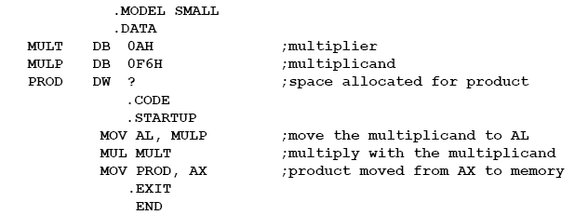
Two bytes stored in the data segment are multiplied. The result of multiplication is available in AX, which is then moved to the location PROD, a word location. Write a program for this.

Slide 72
Factorial
.Model Small
.Data
Fact DW 0 ;space allocated for the factorial
.Code
.Startup
Mov ah,01
int 21h ; enter N from the KB
sub al,30h ;convert ASCII to binary
mov ah,0 ;convert N in AL to a word in AX
mov bx,ax ;mov to bx
mov ax,1 ; ax=1, to start the iteration
cmp bx,0 ; compare bx(=N) to 0
jz final ; if N=0, jump to find 0!
repea: mul bx ; for N not 0, multiply with AX
dec bx ; decrement BX
cmp bx,0 ;compare with 0
jne repea ;repeat if BX is not 0
final: mov fact,ax ; AX=1, hence 0!=1
.exit
.end

Slide 73
Unsigned Division
DIV – Divide
Usage: DIV source
This instruction divides AX or DX – AX by the source, where the source can be a register or a memory location, but not an immediate number.
All the conditional flags are affected, but undefined – hence they do not give any interpretation or information about the result.

Slide 74
Ways of performing division
i. Divide a word by a byte
Here, the dividend must be a word placed in AX and the source must be a byte. The result of division causes AL to contain the quotient, and AH to contain the remainder.
Examples………
DIV BL
DIV BYTE PTR [BX]
DIV DIG

Slide 75
ii. Dividing a byte by a byte.
This is just a special case of a division of a word by a byte. In this case, convert the dividend byte to a word by loading the dividend in AL and 0 in AH.
Thus, AX will be the word that acts as the dividend.

Slide 76
iii. Divide a double word by a word.
In this case, the dividend has to be in AX and DX (the upper word in DX). The divisor should be a word.
The result of this division causes the quotient to be in AX and the remainder to be in DX.
Examples…
DIV BX
DIV WORD PTR [SI]
DIV ANGLE

Slide 77
iv. Dividing a Word by a Word.
Similar to the previous case, if we want a word by word division, extend the word in AX to be a double word by loading 0 in DX to get the dividend to be a double word in AX and DX.

Slide 78
Divide by Zero Error
For division, if the divisor is zero, the quotient becomes undefi ned. In attempting such a division, the 8086 will exit from this program and generate an interrupt.
This state is said to be a ‘divide by zero error’. An interrupt generated by an error, is termed an exception.
If the quotient register is too small to accommodate the quotient, then also this happens.

Slide 79
MOV AX, 09876H
MOV CL, 25H
DIV CL
The above program segment will give a quotient of 41EH, which obviously cannot be accommodated in AL.
Then ,program execution is aborted and the assembler
displays the message ‘divide overflow error’.

Slide 80
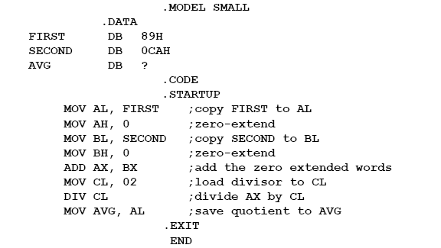
Write a program to find the average of two bytes stored in memory

Slide 81
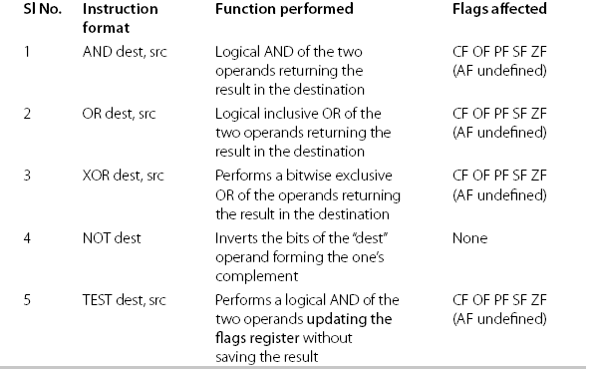
LOGICAL INSTRUCTIONS

